Slide 1
RADAR:
Doppler Effect in Action

Slide 2
Radar: Distance Only
This Photo by Unknown Author is licensed under CC BY-SA

Slide 3
Radar: With Directionality
This Photo by Unknown Author is licensed under CC BY-SA

Slide 4
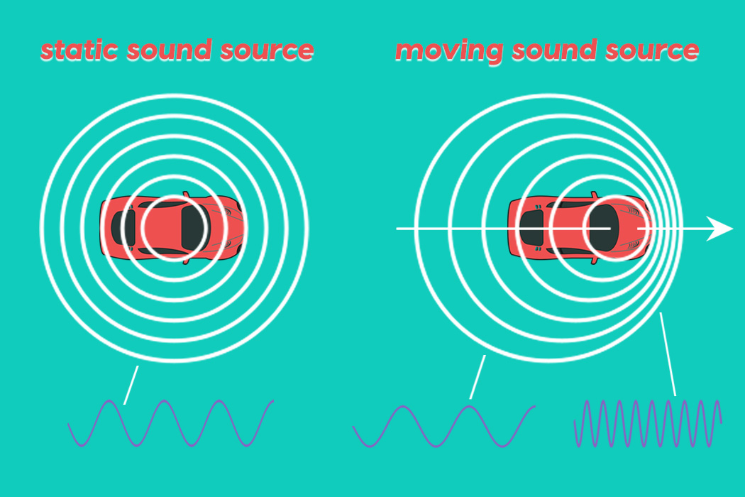
Doppler Effect

Slide 5
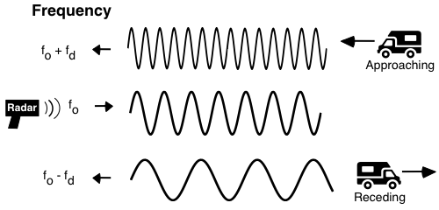
Doppler Effect

Slide 6
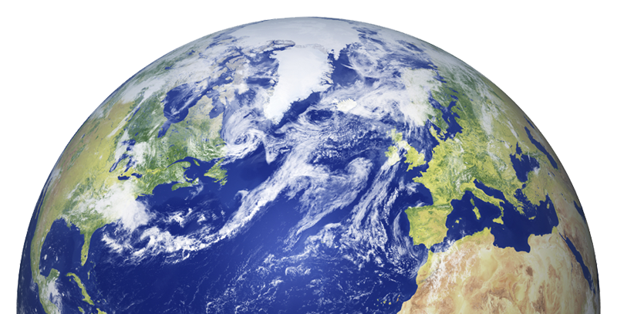
Ground Based Radar

Slide 7
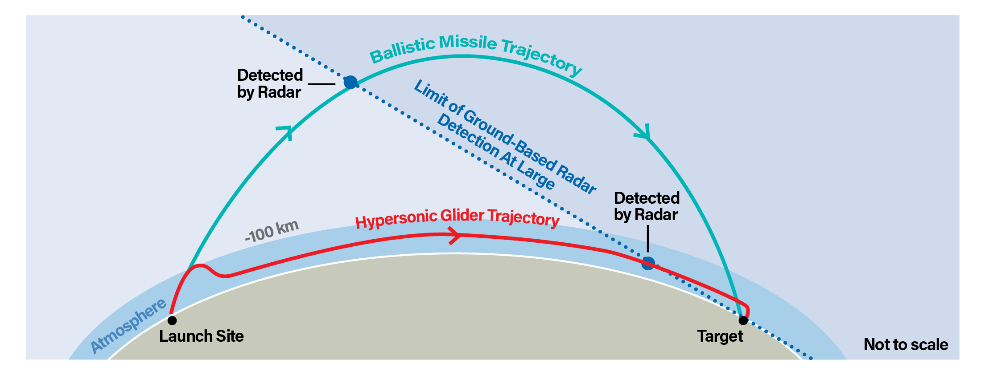
Ground Based Radar

